Slide 1
Telford Playschool Feedback Questionnaire
Thursday, March 26, 2015

Slide 2
26
Total Responses
Date Created: Sunday, February 08, 2015
Complete Responses: 26

Slide 3
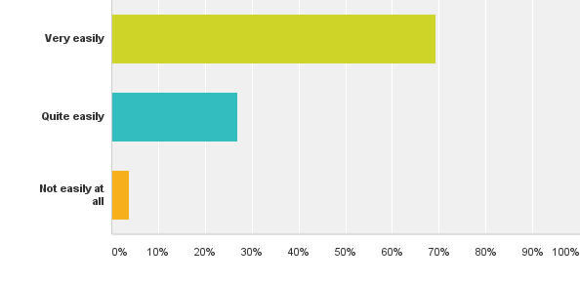
Q1: To enable us to continue to provide a good service, please could you spare a few moments to answer the following questions about Playschool.How easily did your child settle into Playschool?
Answered: 26 Skipped: 0
96% of children settled very or quite easily into Playschool compared with 97% in 2014 and 93% in 2013

Slide 4
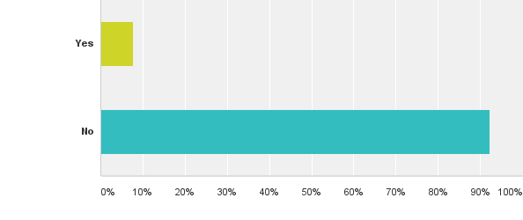
Q2: Is there anything you think we can do to improve the settling in process?
Answered: 26 Skipped: 0
Despite the slight decrease in ease of settling in, an overwhelming majority of 92% (compared with 75% in 2014, 86% in 2013) believed there really was nothing further PlaySchool could do to improve the process for children having difficulties with settling.

Slide 5
Q2: Comments for aiding settling
Positive
Very tailored to the child and I thought it was a great process.
The settling in process was a very sensible one.
The open door policy is a good one and helped.
It has been so reassuring leaving **** with such lovely people, particularly Mrs Allen, Mrs Brooke and Mrs Overton who have kept me up to date and in the loop of my childs progress settling in. Thanks!
Improvements
Maybe more interaction with key worker to aid settling in.
Possibly in terms of ongoing support to detach clingy or tearful children have teachers more willing to encourage a distraction, and encourage them to join in an activity or play with another child. Although this has happened on occasions I have seen and been in the position where the parent is uncertain of how to leave their child it may be that the playschool is very flexible in allowing parents to stay and come in with their child however some parents may be looking for more support from teachers.
ACTION: I believe in the main that Playschool is very open to discussions with any parents who are finding the dropping off process difficult and will try to find ways to assist. I suggest we include a note relating to this on the Newsletter and Facebook to improve awareness.

Slide 6
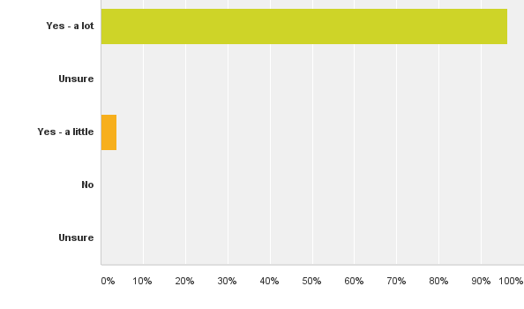
Q3: Does your child enjoy their time at Playschool?
Answered: 26 Skipped: 0
For the second year running 100% of children enjoy their time at Playschool

Slide 7
Q3: Comments
Sometimes in the morning my child is looking around and if all the teachers are busy she is a bit lost. So perhaps just a little more attention paid to children who don't automatically go and find something to do by themselves.
ACTION: Discuss if there is anything we can do to improve this situation

Slide 8
Q4. Please ask your child what they think about Playschool and write down their response.
A snap shot of the responses:
Going to playschool makes me happy. I want to have a sleepover.
I like playing with my friends and Mrs Flynn.
I like doing cooking and babies
"I do like playschool!"
He likes playing with lots of things especially the wiggle wiggles! In his words he likes to do everything!
Good. I like playing on the computer,
I like fruit time
It's exciting
I like playing with my friends and making models

Slide 9
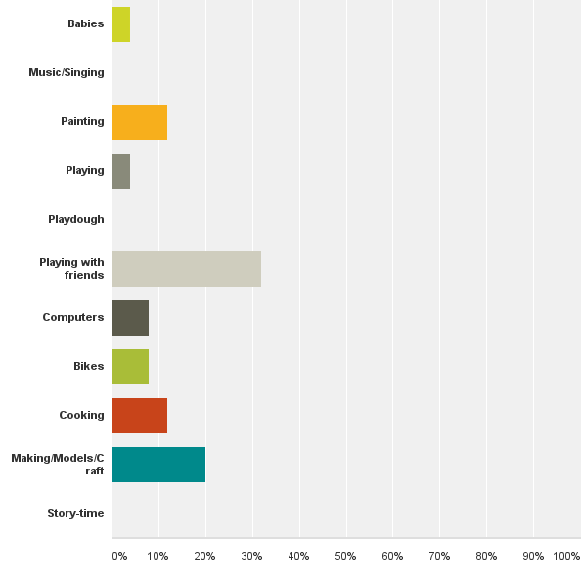
Q5: Please ask your child what their favourite activity at Playschool is? (select one of the options below or enter text into the Other field)
Answered: 25 Skipped: 1
This year’s favourites were playing with friends, model making/craft, painting and cooking.

Slide 10
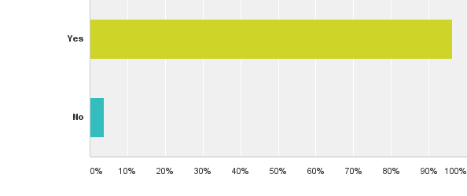
Q6: Do you feel you are kept sufficiently informed about your child's progress?
Answered: 26 Skipped: 0
96% of people felt sufficiently informed, a year on year increase from 78% in 2013 and 87% in 2014, suggesting that the improvements made in communications are working.

Slide 11
Q6: Comments
It would be good to have more structured / regular scheduled meetings to discuss progress as it is difficult whilst playschool is on and at drop off / pick ups. The parents evening is great and would be helpful more often (only been invited to 1 in over a year)
We recently had a very thorough parents evening to discuss our daughter's progress. The staff are always approachable to aske any questions on a daily basis. It's so lovely that at the end of the session, the member of staff on the door will mention to parents waiting in the queue of anything that the children have particularly enjoyed or produced that day, ie, "don't forget to look at her paintings today, they were brilliant!".
ACTION: 2 parents evening are held per year, plus staff can be approached at any time for feedback or request sight of the child's folder. I suggest we put info on Newsletter and Facebook to reinforce our feedback processes as a whole.

Slide 12
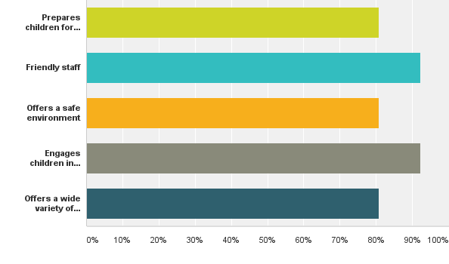
Q7: What do you feel Playschool does well? (select all applicable options below or enter text into the Other field)
Answered: 26 Skipped: 0
Playschool is continuing to meet its key objectives well. One additional comment was made that we also develop social skills

Slide 13
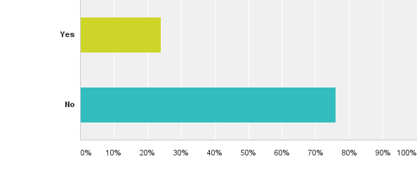
Q8: Have you any ideas of future improvements, fundraising suggestions or any other comments generally?
Answered: 25 Skipped: 1
Comment requesting info on staff names. ACTION: Newsletter and Facebook item with this information, plus directly people to both the website and noticeboard were this information is held.

Slide 14
Q8: Comments
You do loads of fantastic activities with the children and we can tell that a lot of time and effort is put into thinking creatively to get them learning and involved. You cook regularly with them which is great and I just wondered if it would be possible to have them sit together to eat the food they make more often in preparation for school lunches?
Action: Advise via newsletters and facebook that children do sit together during cooking time when tasting on site creations.
A parent offered to assist with a gardening session. I will provide details to Jane/Sandra

Slide 15
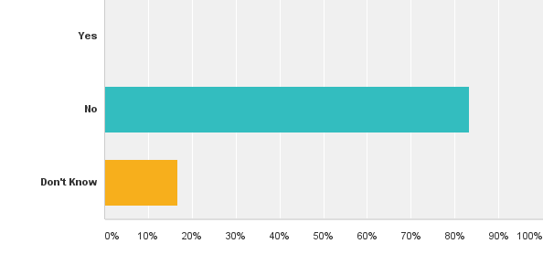
Q10: Does your employer offer match funding? (which means that they would offer to contribute the same as we raised at a specific event, doubling the fundraising income we made)
Answered: 24 Skipped: 2

Slide 16
Actions
All actions from 2014 survey implemented
Some newsletter and facebook items to improve information sharing about how we already operate or where information can be accessed to be addressed. See slides for information specifics.
Overall an a really positive survey result Playschool. Well done all.
Sarah Bull 2015

